Slide 1

CC 141 Discrete Structures Department of Computer Science School of Systems and Technology University of Management and Technology Lahore, Pakistan

Slide 2
Section 5.1 Mathematical Induction

Slide 3
Introduction
Suppose we have an infinite ladder, and we want to know whether we can reach every step on this ladder. We know two things:
We can reach first rung of the ladder.
If we can reach a particular rung of the ladder, then we can reach the next rung.

Slide 4
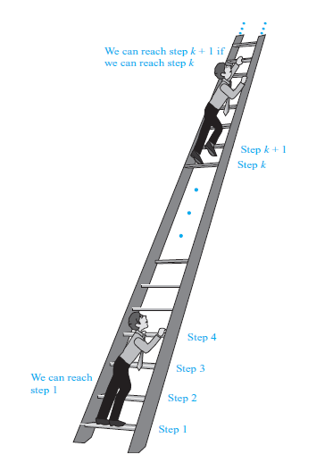

Slide 5
Many theorems state that P(n) is true for all positive integers ‘n’. Where P(n) is a propositional function.
Example:
1 + 2 + 3 + ….. + n = n(n + 1)/2
or
n ≤ 2^{n}

Slide 6
Mathematical induction is a technique for proving theorems of this kind.
In other words, Mathematical Induction is used to prove propositions of the form ∀nP(n).
When
Universe of discourse is the set of positive integers.

Slide 7
Principle of Mathematical Induction
Let P(n) be a propositional function defined for all positive integers n. P(n) is true for every positive integer n if:
Basis Step:
The proposition P(1) is true.
Inductive Step:
If P(k) is true then P(k + 1) is true for all integers k ≥ 1.
i.e. ∀k P(k) → P(k + 1)

Slide 8
Principle of Mathematical Induction

Slide 9
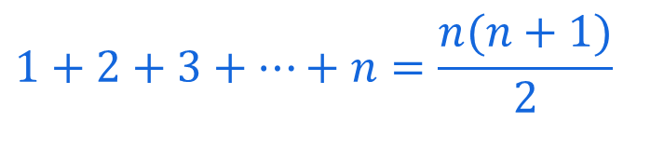
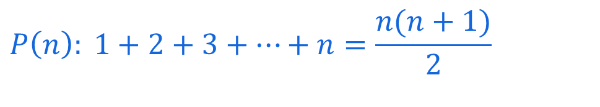
Mathematical Induction … Exercise
Use Mathematical Induction to prove that
for all integers n ≥1
SOLUTION
Let
Basis Step: (prove that theorem is true for n = 1)
Putting n = 1 on both sides
1 = 1(1+1)/2
1=1
Hence theorem is true for n=1
$$1+2+3+⋯+n=\frac{n(n+1)}{2}$$
$$P\left(n\right): 1+2+3+⋯+n=\frac{n(n+1)}{2}$$

Slide 10
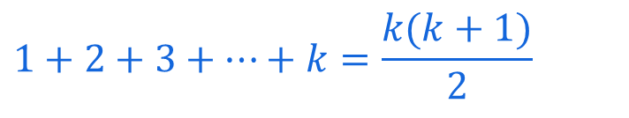

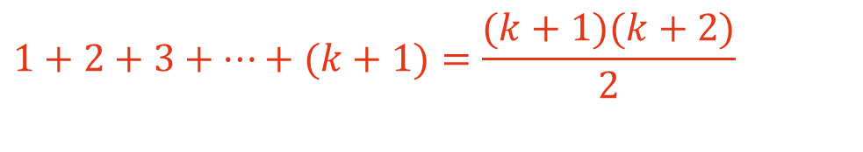
Inductive Step: Suppose P(k) is true for, some integers k ≥ 1.
(1)
To prove P(k + 1) is true. That is, (2)
Consider L.H.S. of (2)
Hence by principle of Mathematical Induction the given result true for all integers greater or equal to 1.
$$1+2+3+⋯+k=\frac{k(k+1)}{2}$$
$$1+2+3+⋯+(k+1)=\frac{(k+1)(k+2)}{2}$$
$1+2+3+⋯+(k+1)=$ $1+2+3+⋯+k+\left(k+1\right)$
= $\frac{k(k+1)}{2}$ + (k+1) using (1)
= (k+1) ($\frac{k}{2}+1)$
= (k+1) ($\frac{k+2}{2})$
= $\frac{(k+1)(k+2)}{2}$ = RHS of (2)

Slide 11
Mathematical Induction … Exercise
Use mathematical induction to prove that
1+3+5+…+(2n -1) = n² for all integers n ≥1.
SOLUTION:
Let P(n) be the equation 1+3+5+…+(2n -1) = n²
Basis Step:
P(1) is true
For n = 1, L.H.S of P(1) = 1and
R.H.S = 1² = 1
Hence the equation is true for n = 1
Inductive Step:
Suppose P(k) is true for some integer k ≥ 1. That is,
1 + 3 + 5 + … + (2k - 1) = k² …………………(1)
To prove P(k+1) is true; i.e.,
1 + 3 + 5 + … +[2(k+1)-1] = (k+1) ² …….…(2)

Slide 12
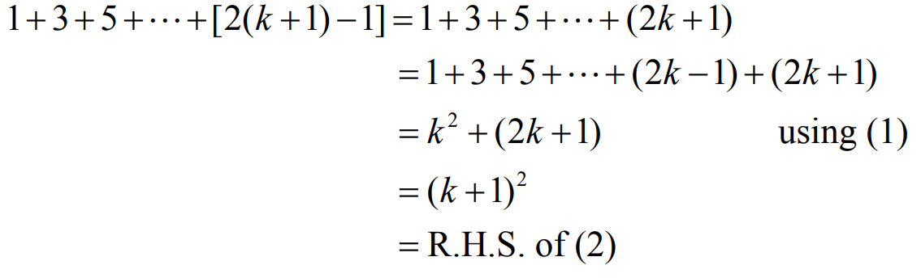
Consider L.H.S. of (2)
Thus P(k+1) is also true. Hence by mathematical induction, the given equation is true for all integers n≥1.

Slide 13
Mathematical Induction … Exercise
Use mathematical induction to prove that
1+2+2² + … + 2^{n} = 2^{n+1} - 1 for all integers n ≥0
SOLUTION:
Let P(n): 1 + 2 + 2² + … + 2^{n} = 2^{n+1} – 1
Basis Step: P(0) is true.
For n = 0
L.H.S of P(0) = 1
R.H.S of P(0) = 2⁰⁺¹ - 1 = 2 - 1 = 1
Hence P(0) is true.
Inductive Step:
Suppose P(k) is true for some integer k ≥ 0; i.e.,
1+2+2²+…+2^{k} = 2^{k+1} – 1……………………(1)
To prove P(k+1) is true, i.e.,
1+2+2²+…+2^{k+1} = 2^{k+1+1} – 1……………..…(2)

Slide 14
Consider LHS of equation (2)
1+2+2²+…+2^{k+1}= (1+2+2²+…+2^{k}) + 2^{k+1}
= (2^{k+1} – 1) +2^{k+1}
= 2·2^{k+1} – 1
= 2^{k+1+1} – 1
= R.H.S of (2)
Hence P(k+1) is true and consequently by mathematical induction the given propositional function is true for all integers n≥0.

Slide 15
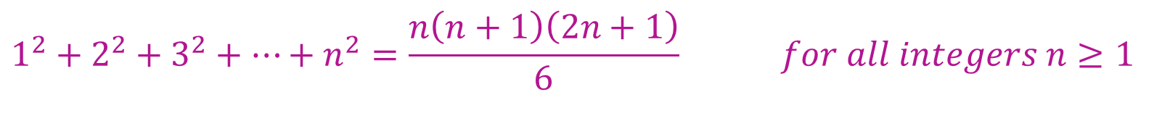
Mathematical Induction … Exercise … Do it yourself
Prove by mathematical induction
$$1^{2}+2^{2}+3^{2}+⋯+n^{2}=\frac{n\left(n+1\right)\left(2n+1\right)}{6} for all integers n≥1$$

Slide 16
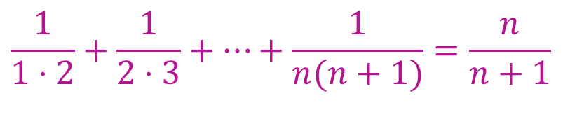
Mathematical Induction … Exercise … Do it yourself
Use Mathematical Induction to prove that
$$\frac{1}{1⋅2}+\frac{1}{2⋅3}+⋯+\frac{1}{n(n+1)}=\frac{n}{n+1}$$
for all integers n ≥1

Slide 17
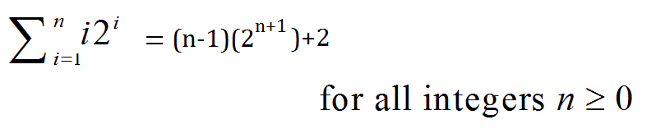
Mathematical Induction … Exercise … Do it yourself
Use Mathematical Induction to prove that

Slide 18
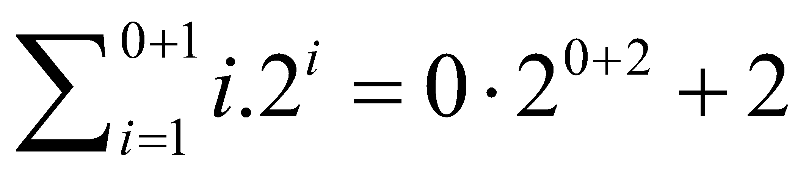
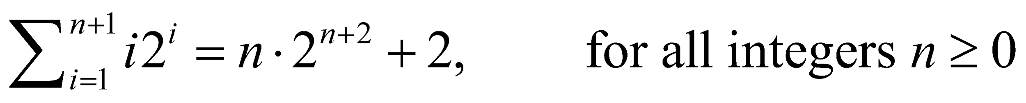
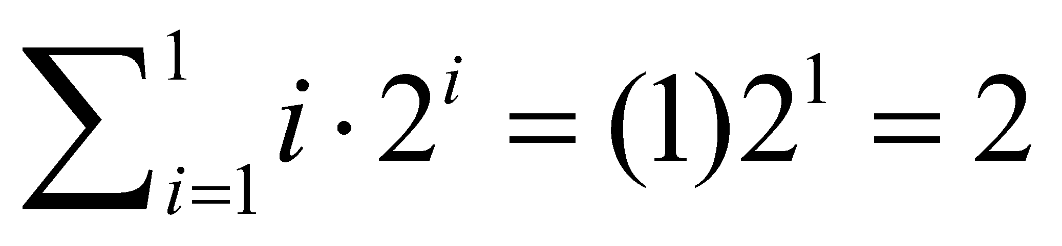
Mathematical Induction … Exercise
Use mathematical induction to prove that
PROOF:
Basis Step:
To prove the formula for n = 0,
we need to show that
Now, L.H.S =
R.H.S = 0·2² + 2 = 0 + 2 = 2
Hence the formula is true for n = 0

Slide 19
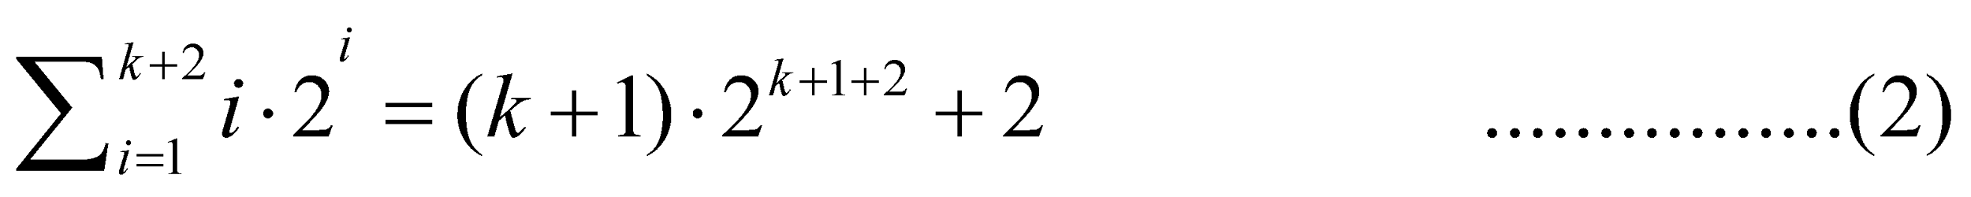
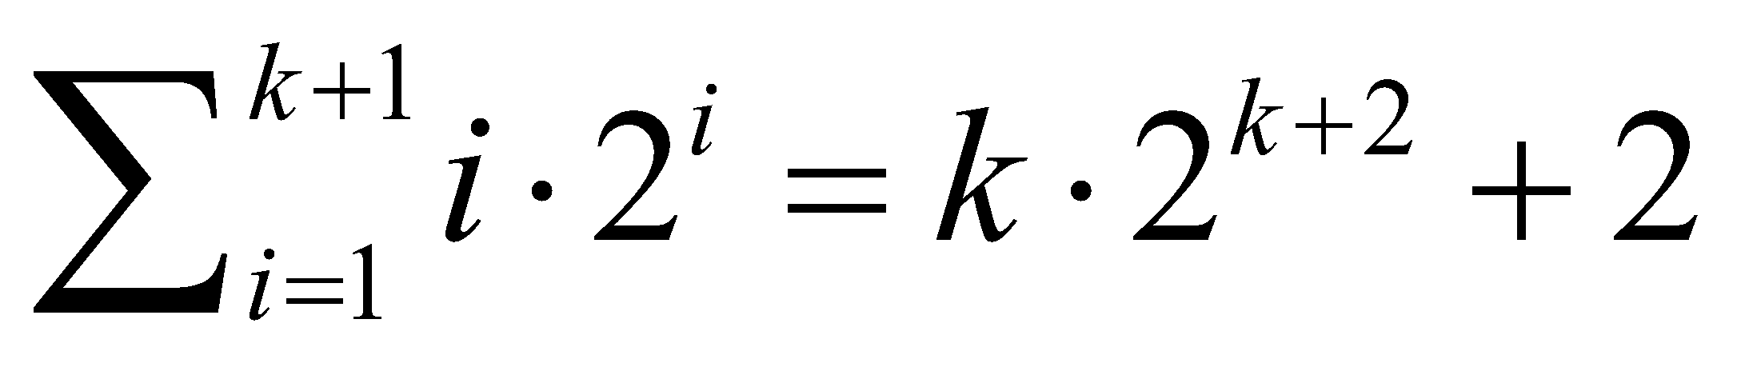
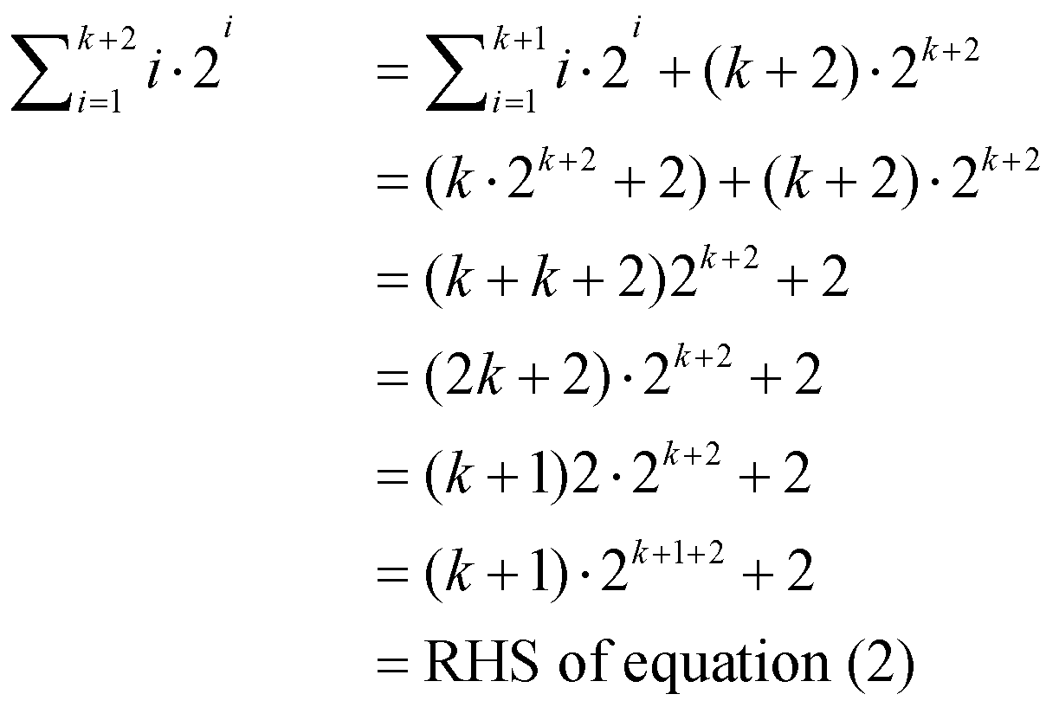
Inductive Step: Suppose for some integer n=k ≥0
………(1)
We must show that
Consider LHS of (2)
Hence the inductive step is proved as well.
Accordingly by mathematical induction the given formula is true for all integers n≥0.

Slide 20
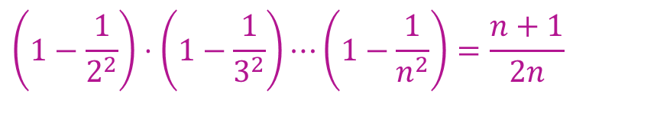
Mathematical Induction … Exercise … Do it yourself
Use Mathematical Induction to prove that
$$\left(1−\frac{1}{2^{2}}\right)⋅\left(1−\frac{1}{3^{2}}\right)⋯\left(1−\frac{1}{n^{2}}\right)=\frac{n+1}{2n}$$
for all integers n ≥2

Slide 21
Mathematical Induction … Exercise … Do it yourself
Use Mathematical Induction to prove that
$$\left(1−\frac{1}{2^{2}}\right)⋅\left(1−\frac{1}{3^{2}}\right)⋯\left(1−\frac{1}{n^{2}}\right)=\frac{n+1}{2n}$$
for all integers n ≥2

Slide 22
Mathematical Induction … Exercise … Do it yourself
Use mathematical induction to prove that 2n < n! for every integer n with n ≥ 4.

Slide 23
Mathematical Induction … More Exercises
Use mathematical induction to prove the following:
n < 2^{n} for all positive integers n.
2^{n} < n! for all n ≥4.
n³-n is divisible by 3 for all positive integers n.
7^{n+2} + 8^{2n+1} is divisible by 57 for every non-negative integer n.
5^{n} - 1 is divisible by 4 for all non-negative integers n.
2^{n+1} > n+2 for all n ≥1.

Slide 24
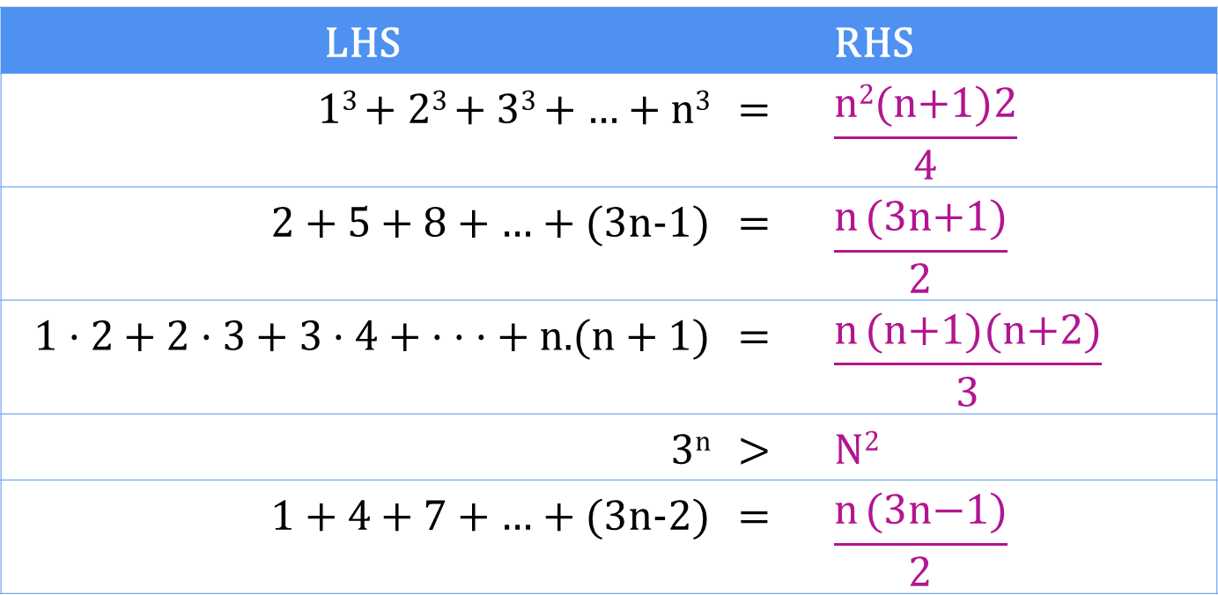
Mathematical Induction … More Exercises
Use mathematical induction to prove the following for all positive integer values of n:
LHS |  | RHS
1³ + 2³ + 3³ + … + n³ | = | $$\frac{\text{n}\text{2}\text{(}\text{n}\text{+1)2}}{4}$$
2 + 5 + 8 + … + (3n-1) | = | $$\frac{\text{n} \text{(}\text{3}\text{n}\text{+1)}}{2}$$
1 · 2 + 2 · 3 + 3 · 4 + · · · + n.(n + 1) | = | $$\frac{\text{n} \text{(}\text{n}\text{+1)(}\text{n}\text{+2)}}{3}$$
3^{n} | > | N²
1 + 4 + 7 + … + (3n-2) | = | $$\frac{\text{n} \text{(}\text{3}\text{n}\text{−}\text{1)}}{2}$$

Slide 25

Summary
The topics we covered:
Mathematical Induction
Principal of Mathematical Induction
Practice Questions

